Slide 1
Introduction to NeLS and Galaxy
The national bioinformatics infrastructure
Erik Hjerde

Slide 2
NeLS - the Norwegian e-Infrastructure for Life Science
ELIXIR.NO
International
NeLS
National
Users
National infrastructures
Compute
Storage
Support
Data management
Helpdesk
Training
UiO
UiT
NMBU
NTNU
UiB
Data management
Data storage
Data sharing
Data analysis
Notes:
Data storage and sharing – short and long term - collaborative, streamlined upload from data generated at Norseq
Data management – planning, storing, sharing data – Data management plan
Data analysis – reproducible, through available Galaxy pipelines

Slide 3
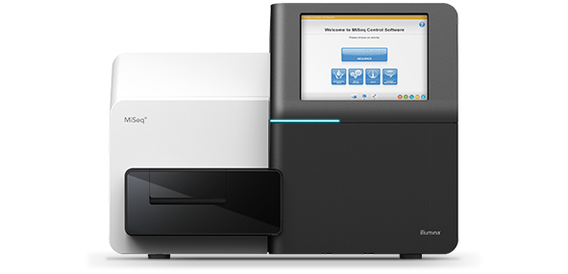
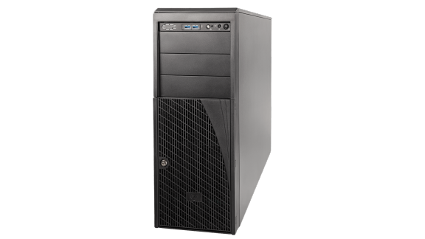
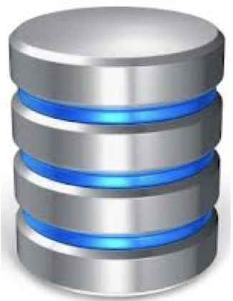



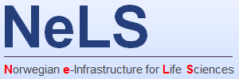




Overview of data management
FAIR data management from sequencing provider to public repository
Data production
Data storage/sharing
Data compute
Data archiving
Data management
Notes:
This involves capturing metadata as early as possible

Slide 4
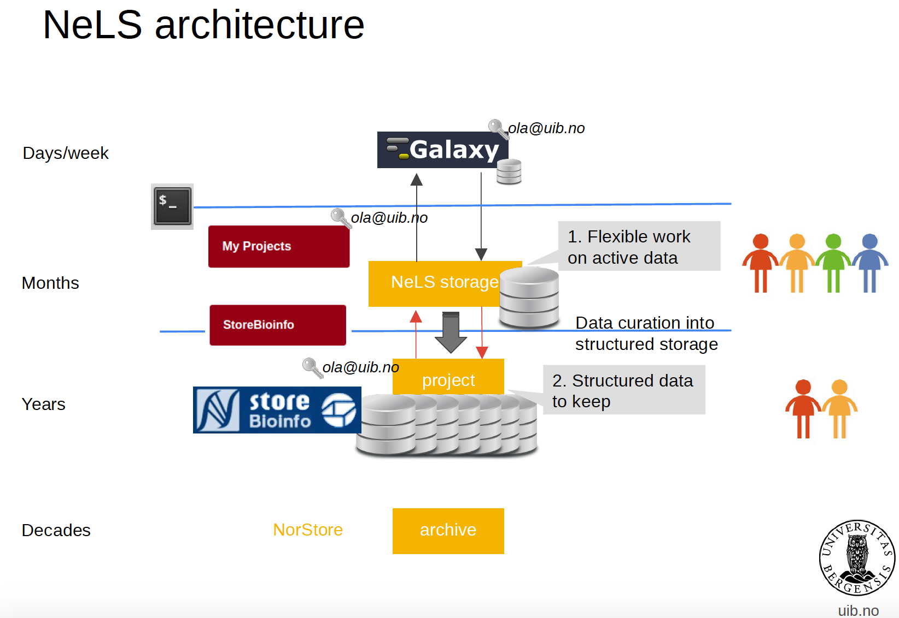




NeLS architecture
Research data archive

Slide 5
Data from data providers
Research data archive
Notes:
Directly deposited into NeLS/SBI

Slide 6
Data storage in NeLS and StoreBioInfo
Research data archive
Notes:
Common for all: sharing of data between members of the project different permissions (read-only, reads-write, PI can add people to the project)

Slide 7
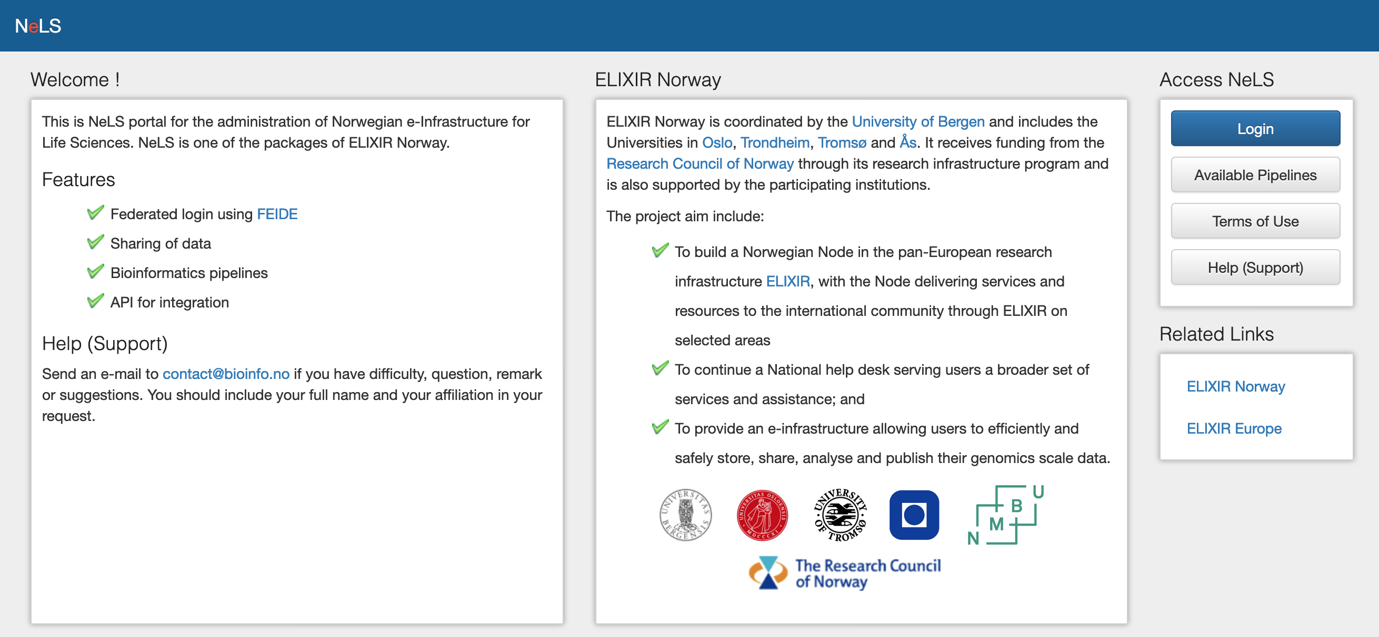
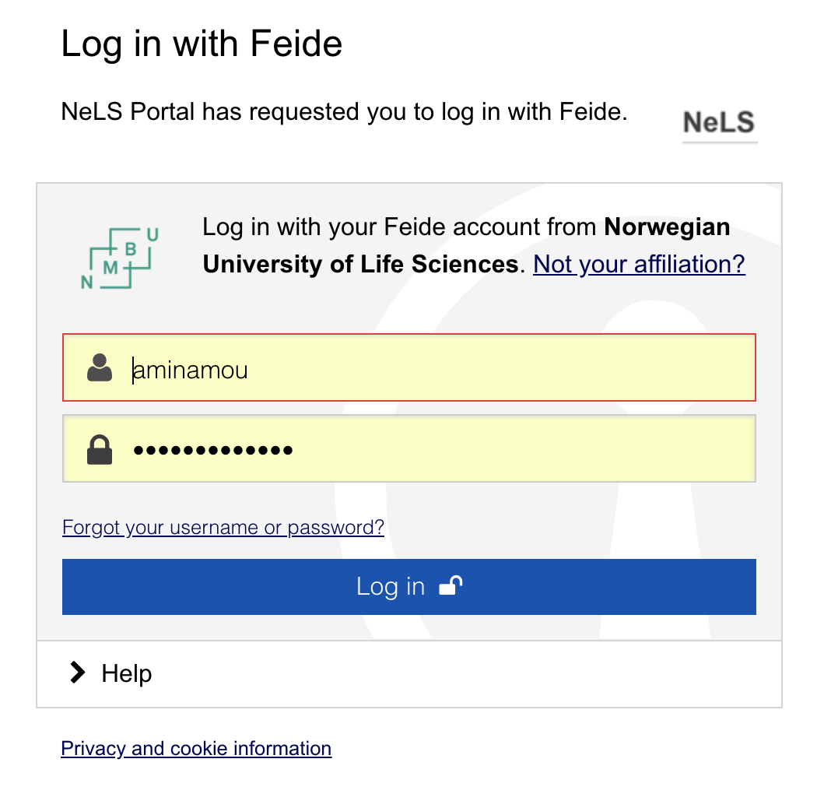
Access to storage and sharing of data in NeLS
Temporary storage – typically during the data analysis and manuscript preparation
Users with permissions can access data in a NeLS project (FEIDE or NeLS ID)
Notes:
Either with FEIDE login NeLS login for non-FEIDE users (eg. External collaborators)
Possible to access through the portal or through ssh (and API)

Slide 8
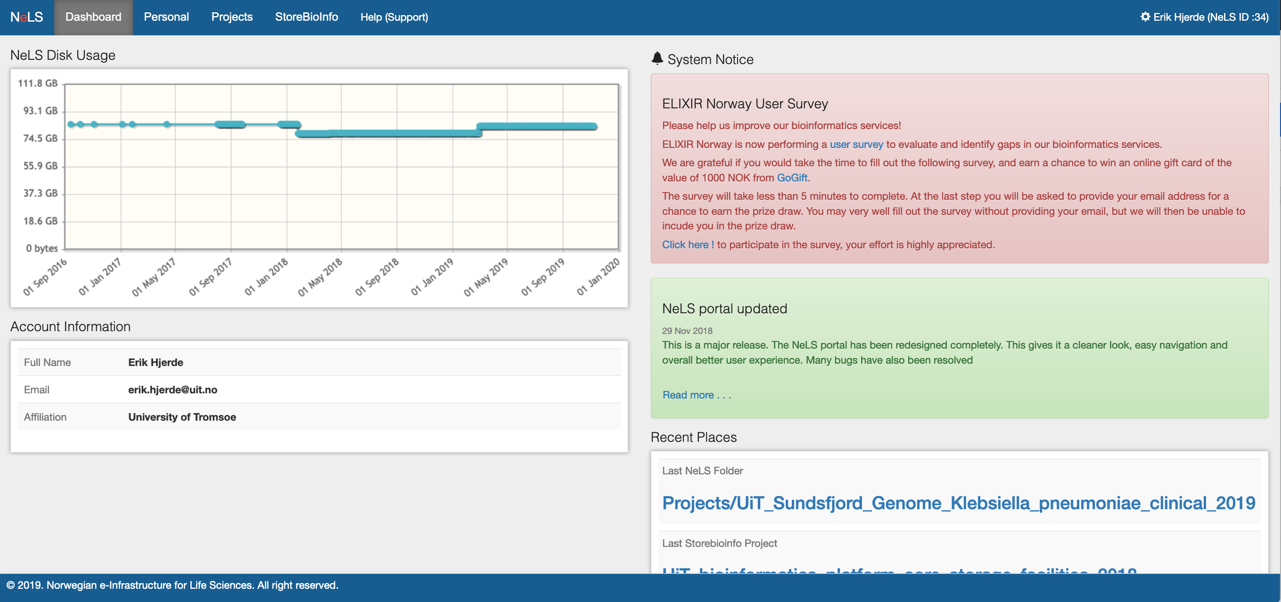
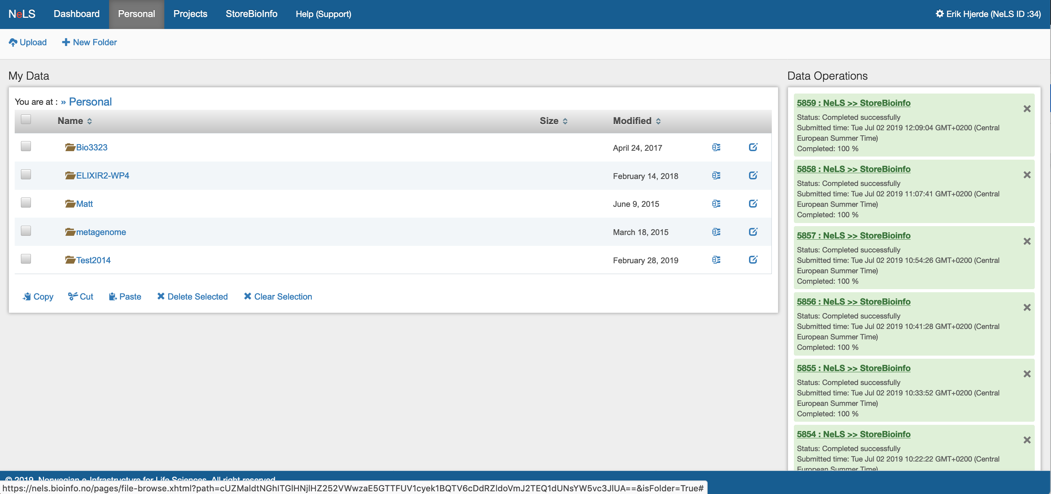
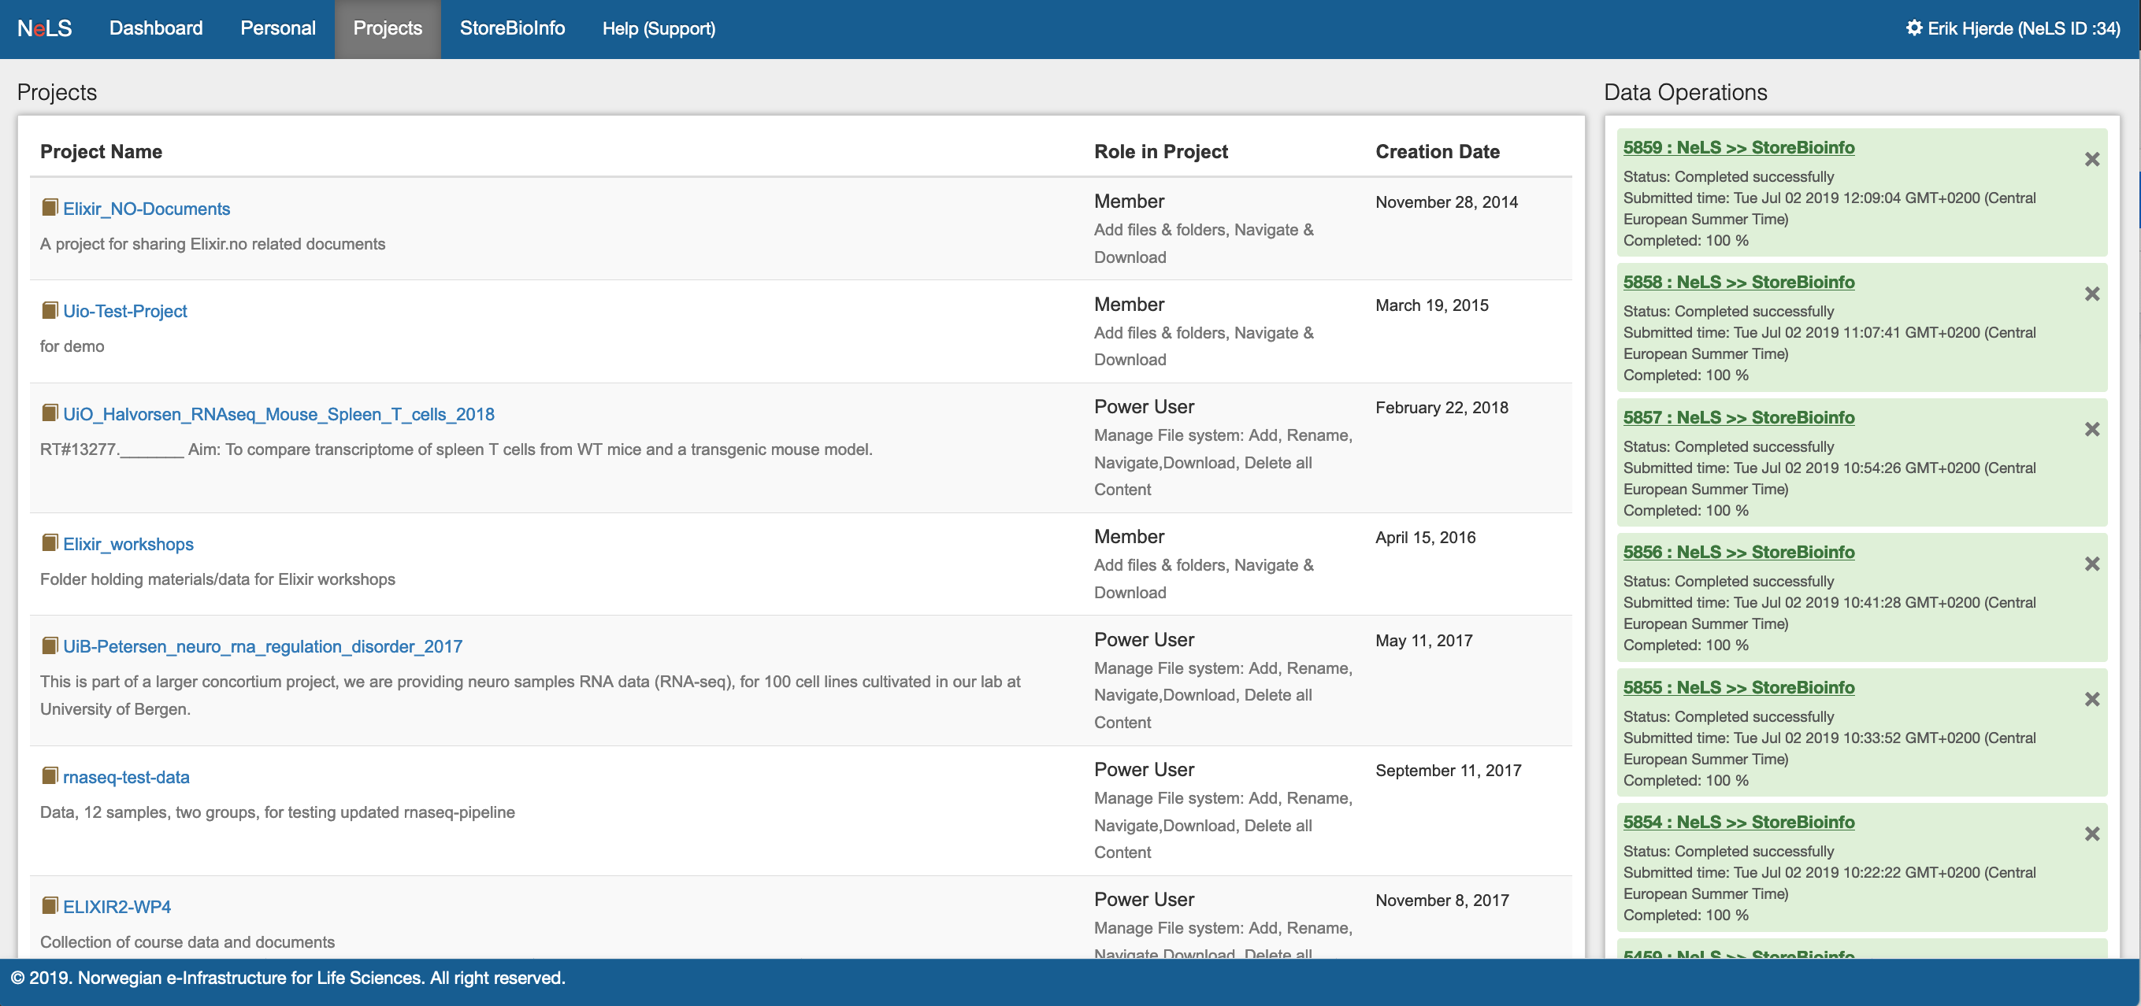
Access to storage and sharing of data in NeLS
Access to personal storage and projects
Notes:
Access to personal storage and projects and SBI
Managing data – different roles

Slide 9
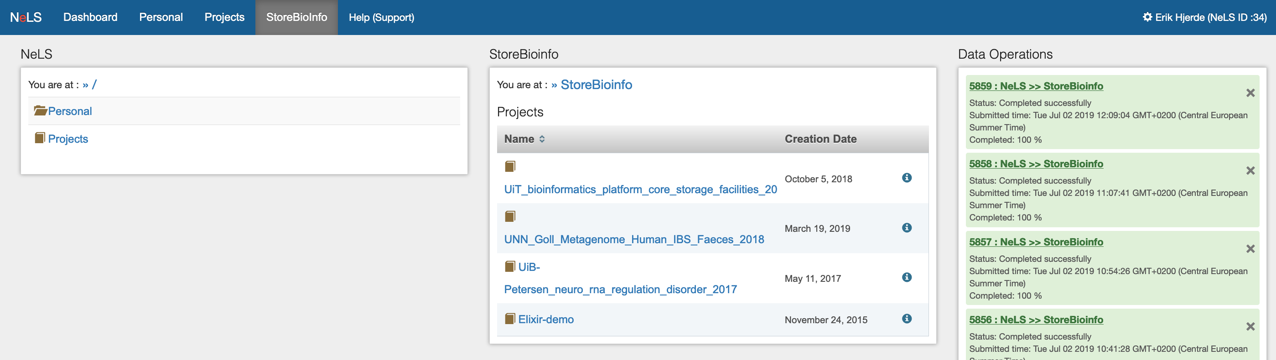
Data storage in StoreBioInfo
Long term storage – typically for large projects where data is used in several publications
Storage quotas has to be applied for – typically > 1TB data

Slide 10

Sensitive data in TSD
Research data archive
Notes:
Sensitive data must be stored, accessed and analyzed according to strict guidelines

Slide 11
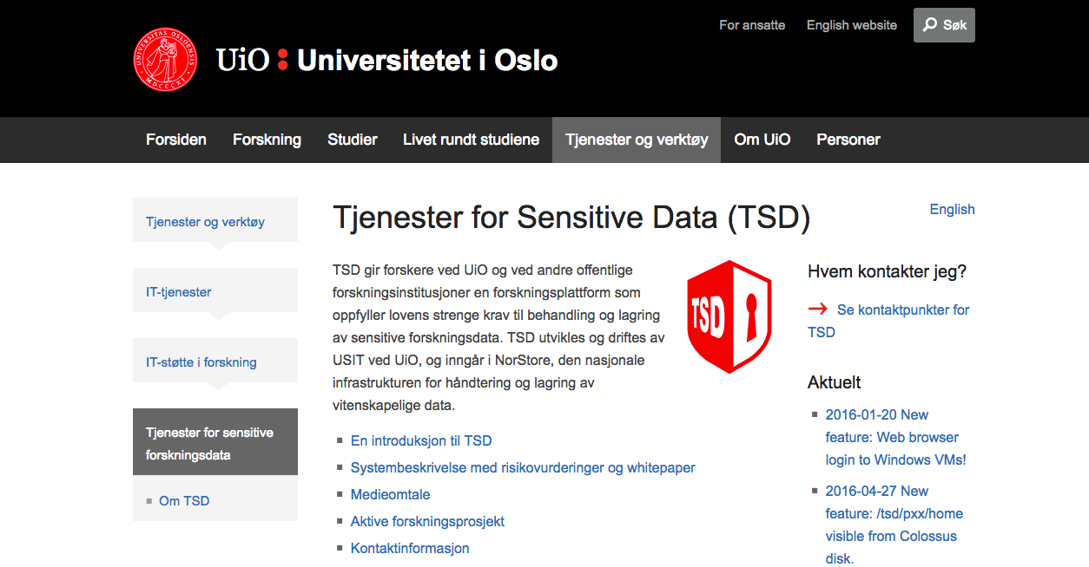
TSD – Tjenester for Sensitive Data
National infrastructure for computing and data management of sensitive data
Fulfils the requirements by Norwegian law for treatment and storage of sensitive data
TSD is developed and hosted by USIT at the UiO
The NeLS-portal is the only web entry point to get data in and out of TSD

Slide 12
Data analysis
Research data archive
Notes:
Data can be pushed directly from the NeLS storage to NeLS Galaxy for analysis

Slide 13
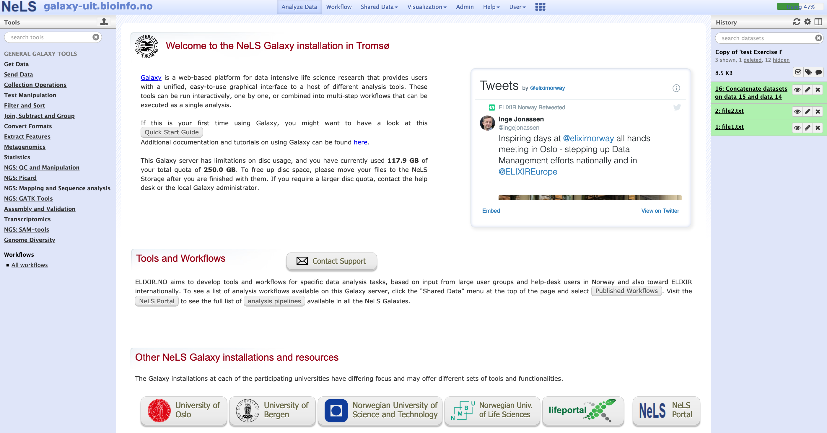
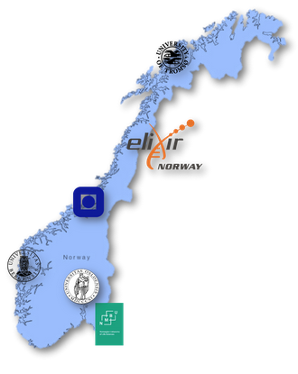
Data analysis in NeLS Galaxy
Each node host a Galaxy server with unique “flavour”

Slide 14
Data archiving in data repositories
Research data archive
Notes:
Archiving – typically when a project is ending

Slide 15
Overview of data management
FAIR data management from sequencing provider to public repository
Data production
Data storage/sharing
Data compute
Data archiving
Data management
Notes:
This involves capturing metadata as early as possible

Slide 16
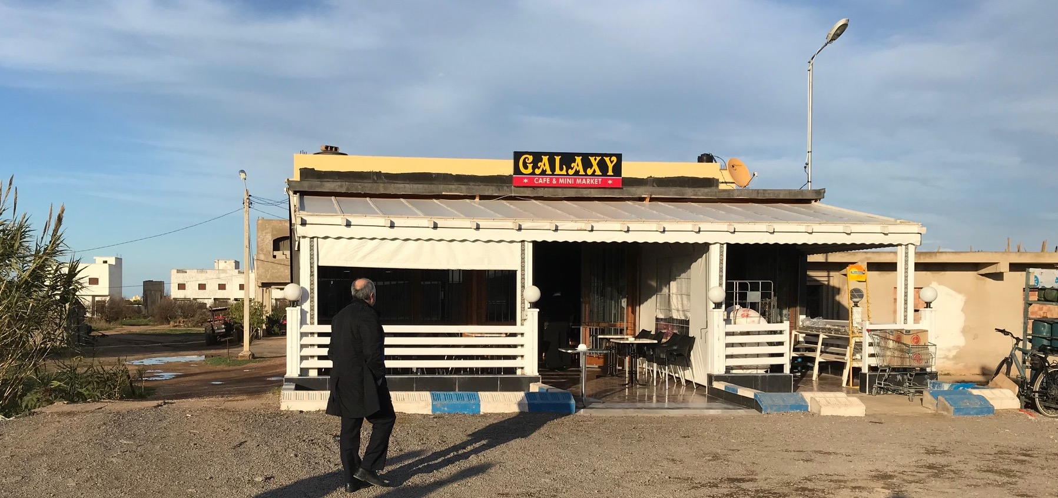
Now Galaxy…

Slide 17
Data analysis in NeLS Galaxy
Galaxy: open, web-based platform for accessible, reproducible, and transparent computational biomedical research
This give access to multiple tools and data analysis workflows
Notes:
The user can also switch to another NeLS Galaxy at other Norwegian Universities

Slide 18
Data analysis in NeLS Galaxy
Quick start guide:
Galaxy basics
Uploading local data files into Galaxy
How to import/export data from NeLS storage
Dataset collections
Running tools
Workflows
Total quota 250 GB
Contact support
Q&A forum

Slide 19
Galaxy – The basics
Main menu
Main menu
Tool menu
Main window
Tool menu
Main window
History

Slide 20
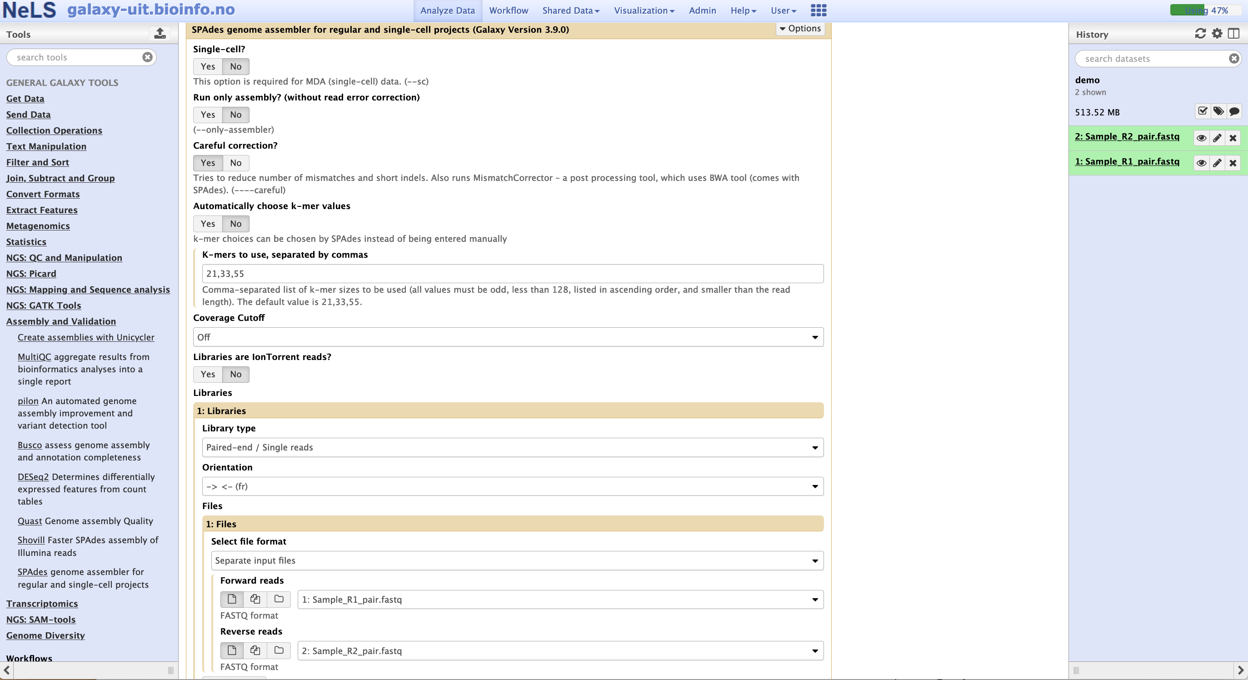
Galaxy - Tools
Tools are available from the Tool menu
Command line tools are wrapped into to Galaxy so they become accessible with a GUI
Notes:
Example SPAdes

Slide 21
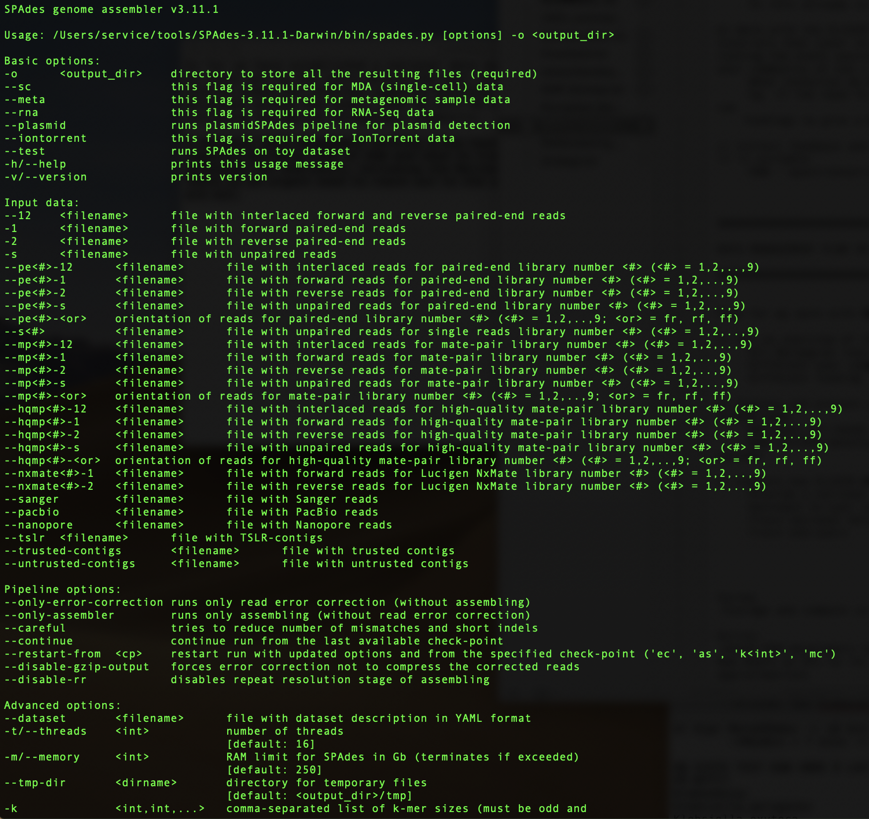
Galaxy - Tools
Tools are available from the Tool menu
Command line tools are wrapped into to Galaxy so they become accessible with a GUI
Notes:
Example SPAdes

Slide 22
Galaxy - Tools
Example running SPAdes
Choose parameter settings
Select input files
Notes:
Example SPAdes

Slide 23
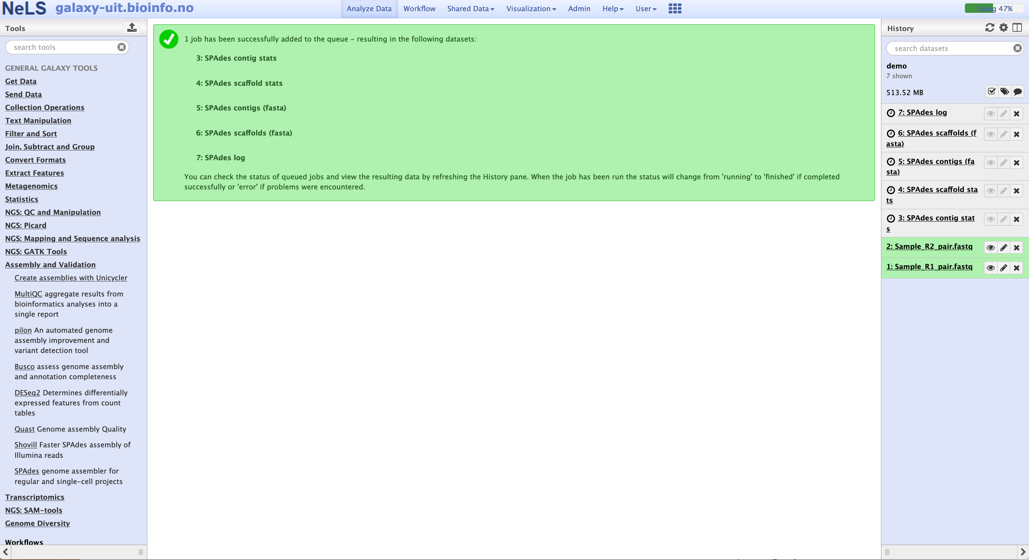
Galaxy – Running tools
The result files are first displayed in grey boxes. This means the job is pending.

Slide 24
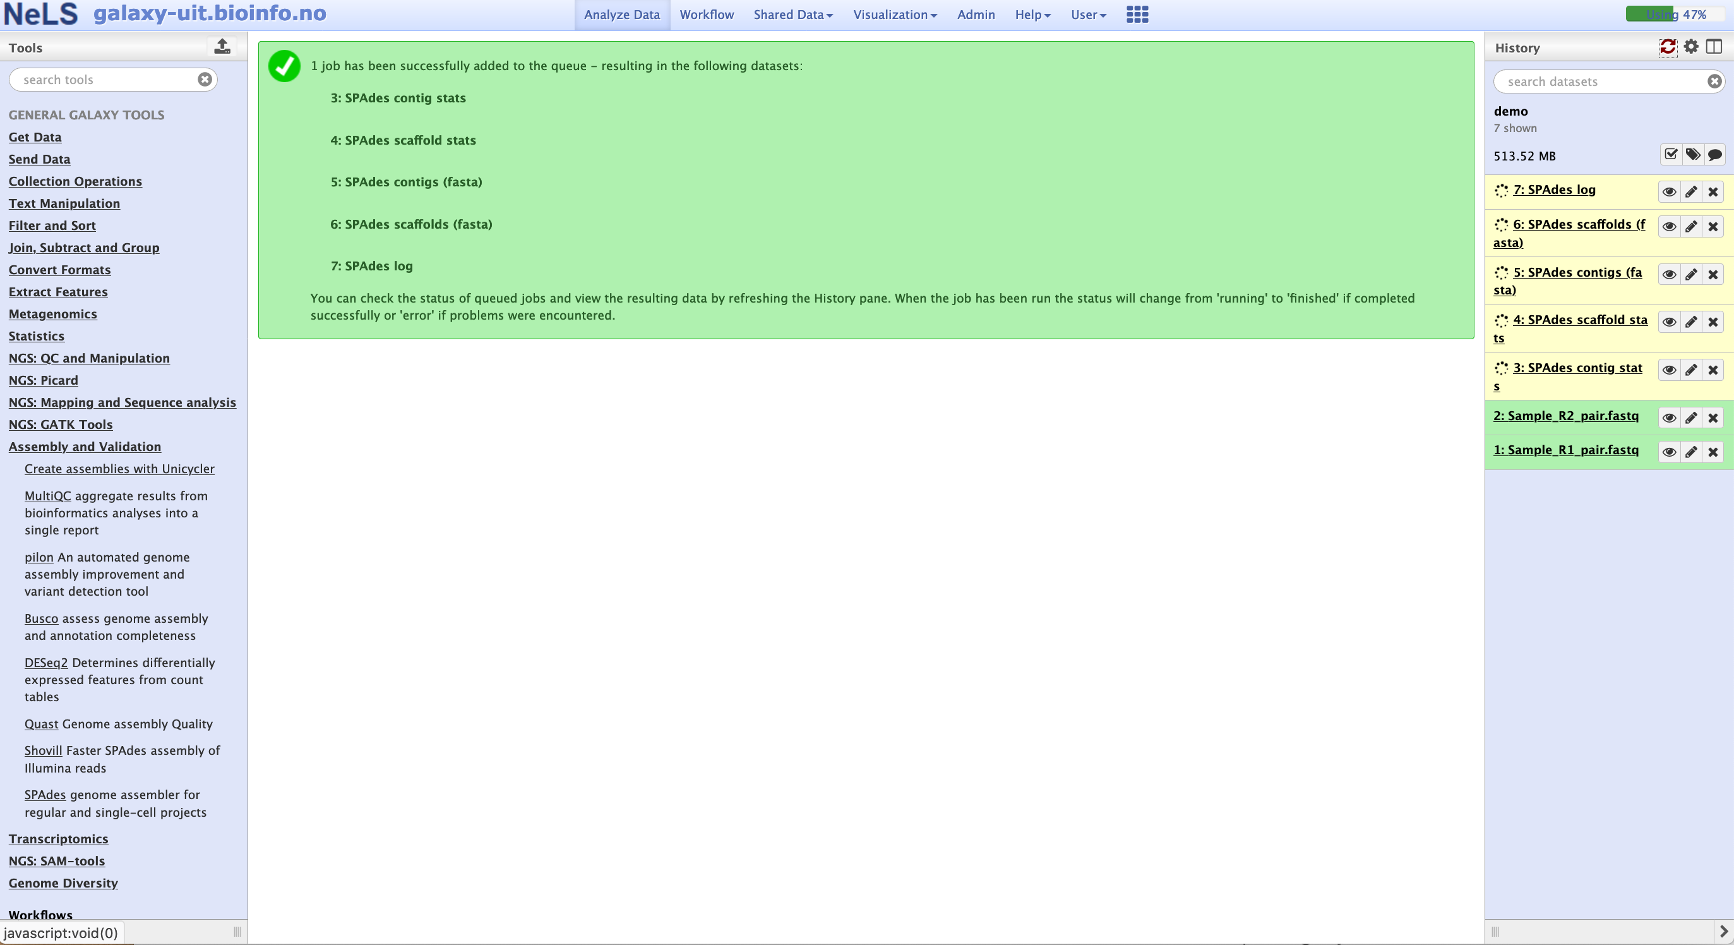
Galaxy – Running tools
When the job is running, the files turns yellow

Slide 25
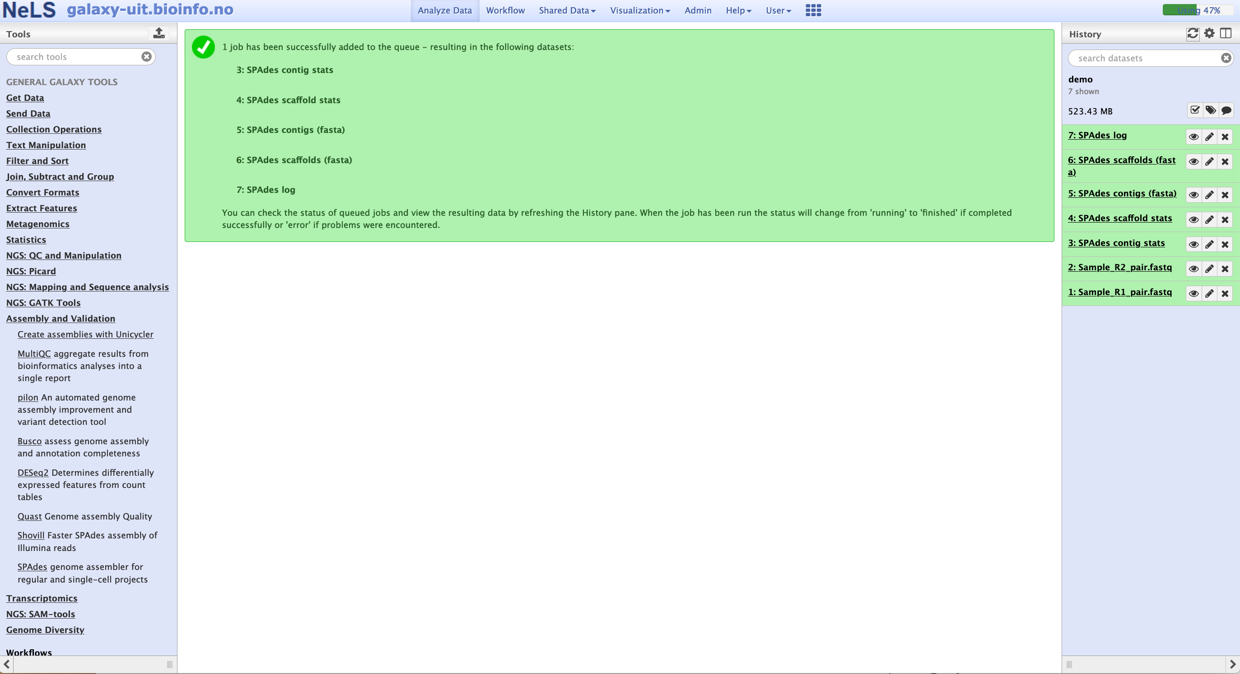
Galaxy – Running tools
When the job finish successfully, the files turn green

Slide 26
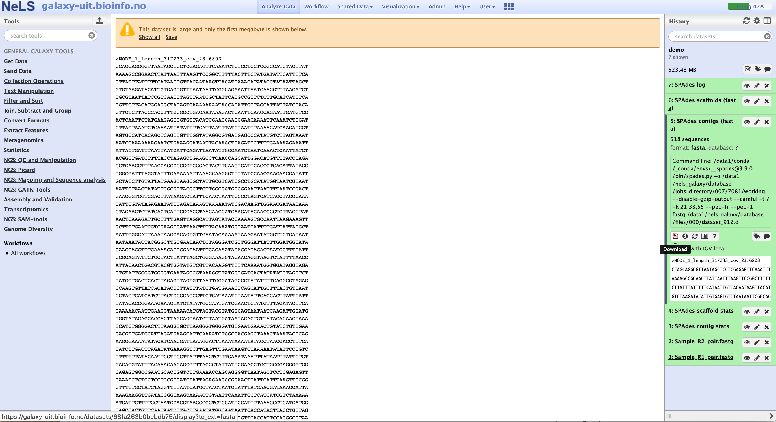
Galaxy – Running tools
You can view and download the result files

Slide 27
Galaxy workflows
A workflow in Galaxy is basically a string of tools, where the output from one tool becomes the input for the next
Tool 1
Tool 2
Tool 3
Output
Output
Output

Slide 28
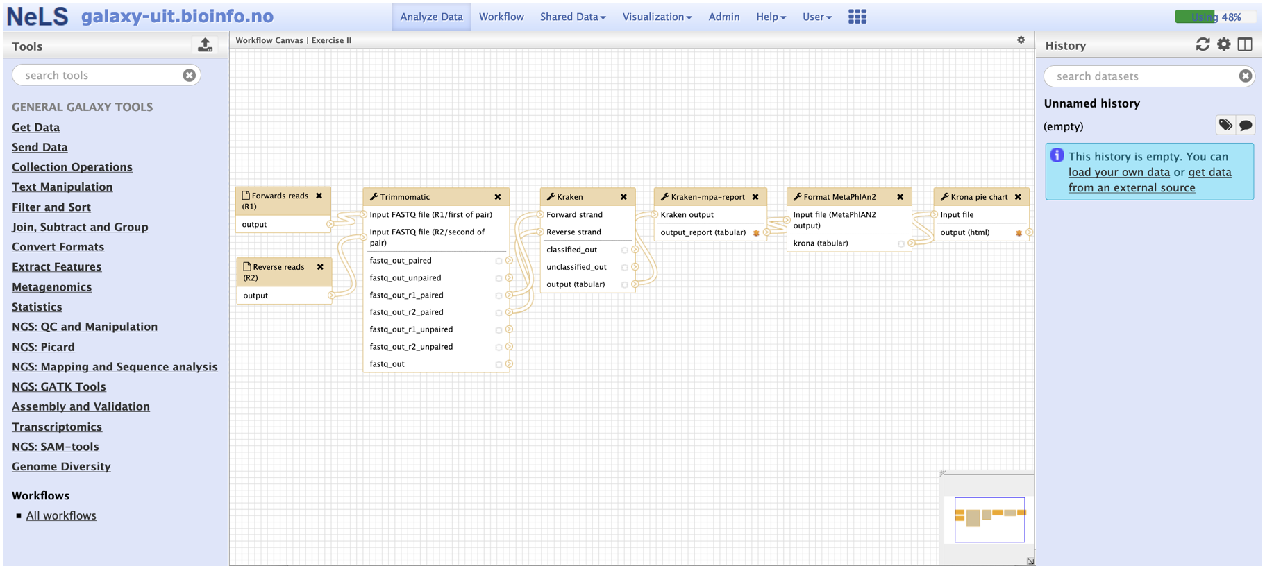
Galaxy - Workflows
The “nodules” indicate which output file from one acts as input for the next tool

Slide 29
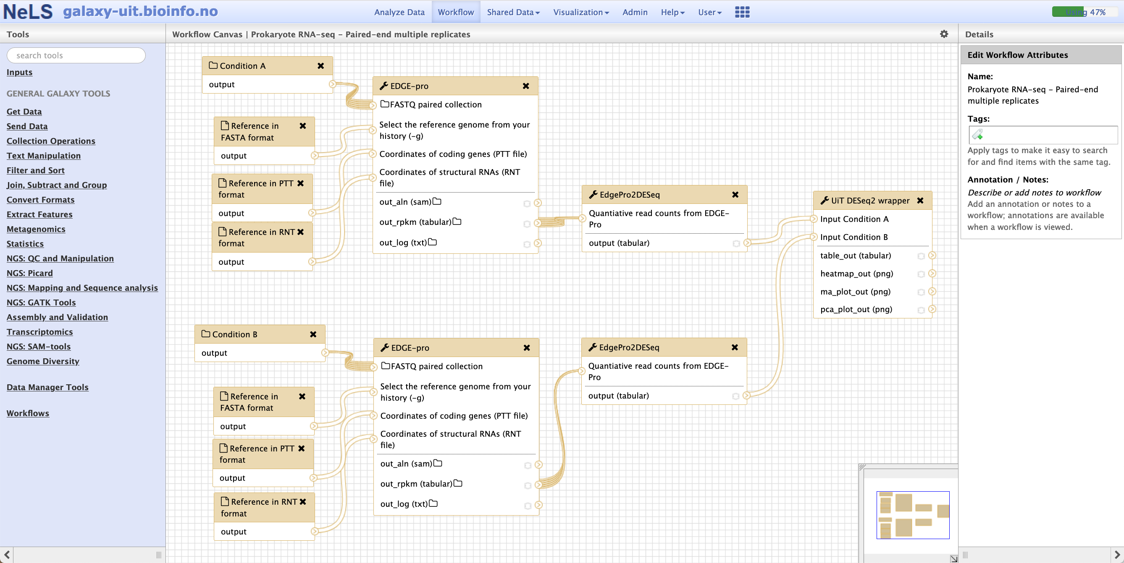
Galaxy - Workflows
The “nodules” indicate which output file from one acts as input for the next tool
Multiple files can act as input for a tool

Slide 30
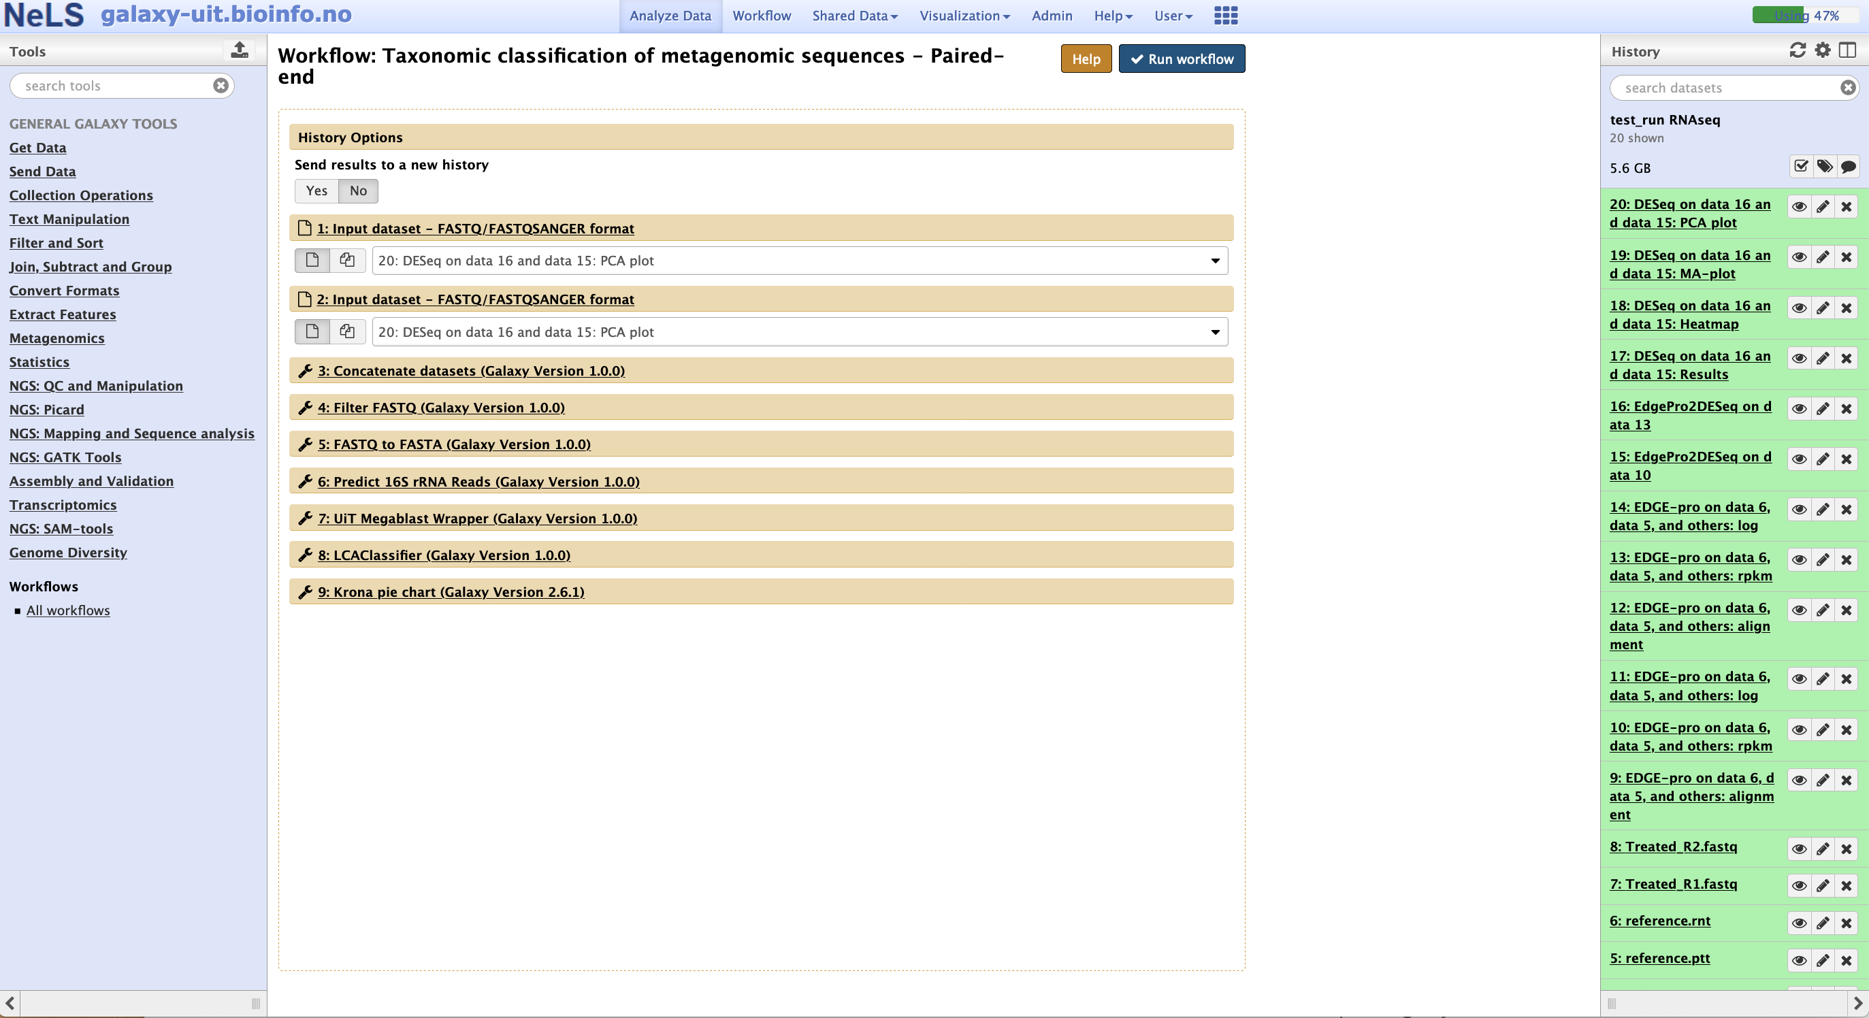
Galaxy – Running workflows
You can view and download the result files

Slide 31
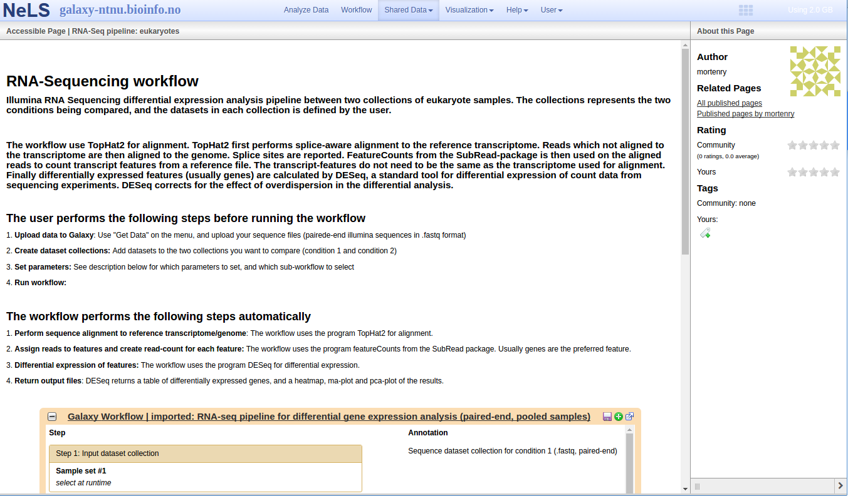
Galaxy – Workflow documentation
Each NeLS supported workflow is documented with instructions how to use it
Also test data sets available for each workflow

Slide 32
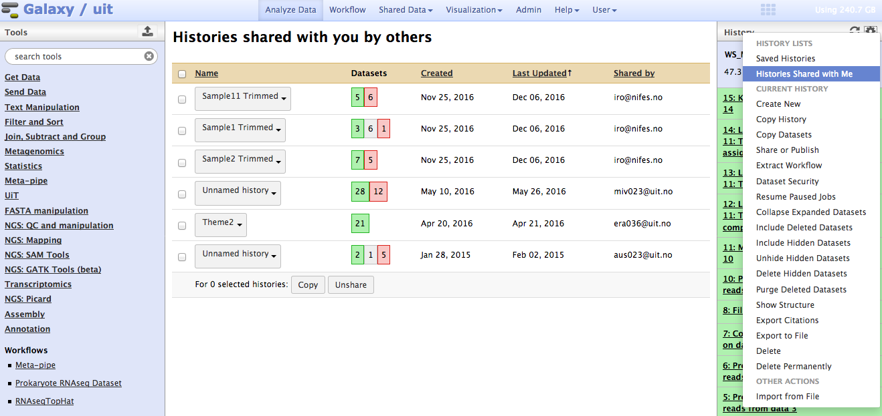
Galaxy - Additional features
Histories can be named and saved
Histories can easily be shared with other users on same galaxy server
Workflows can easily be shared with other users on same galaxy server

Slide 33
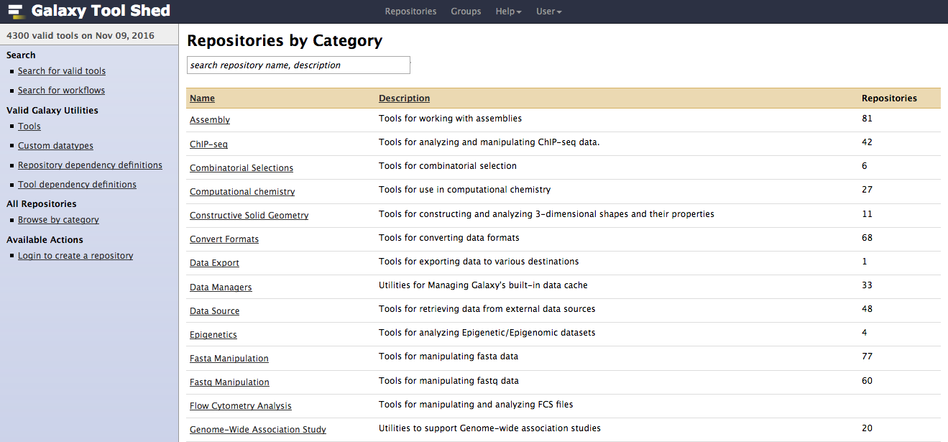
Galaxy – New tools
Tool shed = appstore
Central repository for bioinformatic tools
Each tool has a wrapper
Necessary for Galaxy to execute the software
Hosted by the developers of Galaxy

Slide 34
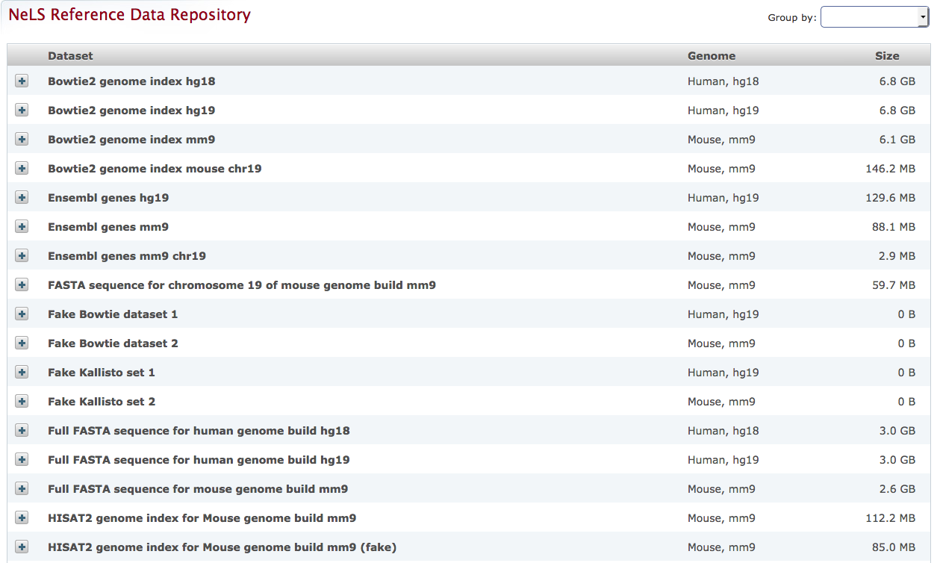
Galaxy – Helpdesk assistance
New reference data
New tools/wrappers
New public workflows if needed by many
Hands-on workshops regularly

Slide 35
Future developments
Merge all five NeLS Galaxy into one – usegalaxy.no
Direct data upload and archiving in ENA from NeLS
Development of more analysis workflows (on demand)
Integration of Jupyter notebooks in Galaxy

